Slide 1
Faustine
une plate-forme Faust vectorielle
pour le traitement de signal multimédia
Karim Barkati, Haisheng Wang, Pierre Jouvelot
CRI MINES ParisTech
28 octobre 2013

Slide 2
Somme de 4 sinus normalisée

Slide 3
import("math.lib"); samplerate = 44100;
process = s(1378) , s(2067) , s(16536) , s(22000) :> + : /(4) ;
s(f) = 2.0*PI*f*t/samplerate : sin;
t = ( +(1) ~ _) - 1;
output0[i] = (FAUSTFLOAT)(0.25f * (sinf((0.19633173136719884f * iTemp0)) +
((sinf((3.13446886072451f * iTemp0)) + sinf((0.2944975970507983f * iTemp0))) +
sinf((2.3559807764063865f * iTemp0)))));

Slide 4
import("math.lib"); samplerate = 44100;
process = s(1378) , s(2067) , s(16536) , s(22000) :> + : /(4) ;
s(f) = 2.0*PI*f*t/samplerate : sin;
t = ( +(1) ~ _) - 1;
virtual void compute (int count, FAUSTFLOAT** input, FAUSTFLOAT** output) {
FAUSTFLOAT* output0 = output[0];
for (int i=0; i<count; i++) {
iRec0[0] = (1 + iRec0[1]);
int iTemp0 = (iRec0[0] - 1);
output0[i] = (FAUSTFLOAT)(0.25f * (sinf((0.19633173136719884f * iTemp0)) + ((sinf((3.13446886072451f * iTemp0)) + sinf((0.2944975970507983f * iTemp0))) + sinf((2.3559807764063865f * iTemp0)))));
// post processing
iRec0[1] = iRec0[0];
}
}

Slide 5
Faust
« functional audio stream »
Algèbre de blocs-diagrammes
Traitement du signal audio temps réel
Orienté performance
Compilateur écrit en C++
Génération de code: C, C++, LLVM, Java, javascript; MaxMSP, Pure Data, SuperCollider; LaTeX, SVG, Qt, etc.

Slide 6
Plan
Faust
FFT / vecteurs
LicensePlate / opérations morphologiques
Faustine@cri
Discussion : design et performances
Perspectives

Slide 7
Pas de FFT?!

Slide 8
faustine -f fft.dsp -i sinsum.wav :-)

Slide 9
Pierre Jouvelot and Yann Orlarey. Dependent vector types for data structuring in multirate Faust. Comput. Lang. Syst. Struct., 37:113–131, July 2011.
vectorize :
serialize :
[ ] :
# :

Slide 11
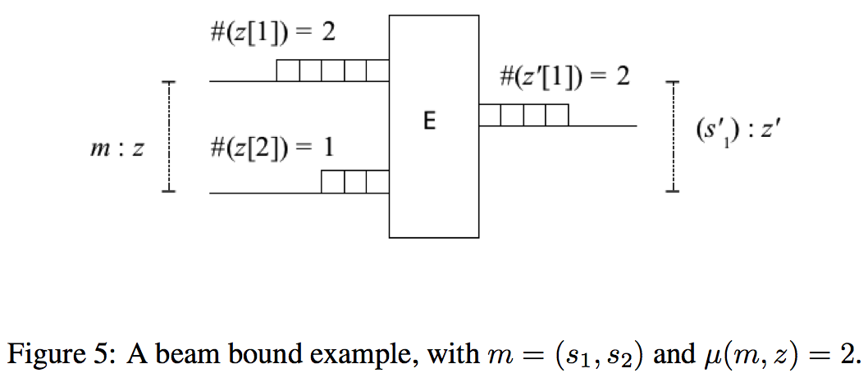

Slide 12
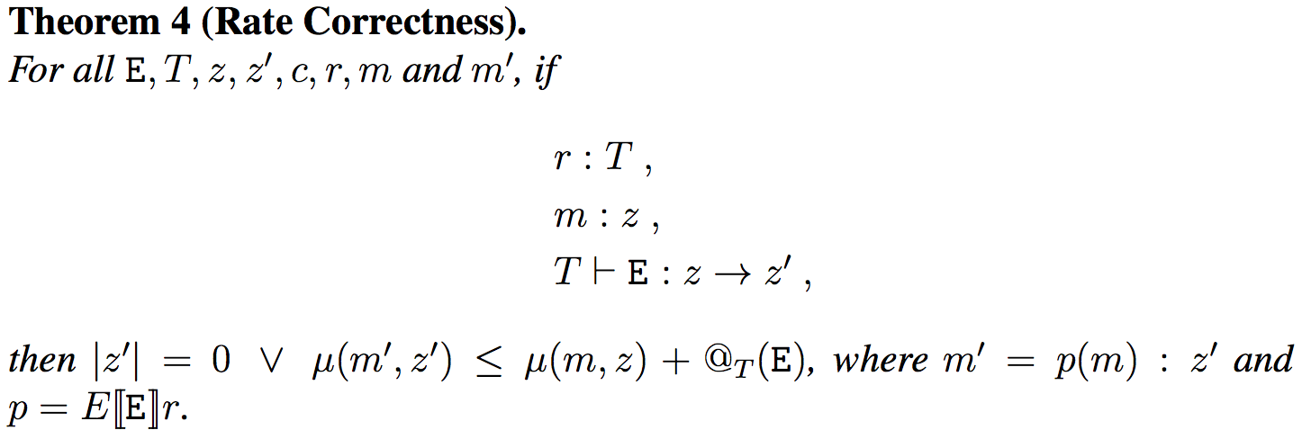

Slide 13
complex.lib

Slide 15
subsampling(n) = (_,n) : vectorize : [0];
t = _ ~ (1,_ : +);
process = t : subsampling(2);

Slide 16
Butterfly: O(N²) -> O(N log(N))

Slide 17
import ("fft.lib"); import ("complex.lib");
// Complex add and sub of butterfly-interleaved signals
butterfly(n) = (bus(n/2) , par(k, n/2, twiddle_mult(k, n))) <:
interleave(n/2, 2) , interleave(n/2, 2) :
par(i, n/2, pcplx_add) , par(i, n/2, pcplx_sub);
butterflies(2) = xbutterfly(2);
butterflies(n) = (butterflies(n/2) , butterflies(n/2)) : butterfly(n);
picks(n) = par(i, n, [ i ]);
fft(n) = _ <: picks(n) : real2pcplx(n) : shuffle(n) : butterflies(n);
process = vectorize(8) : fft(8) : pcplx_modules(8) : nconcat(8) : serialize;

Slide 18
LicencePlate chez Faustine

Slide 19
import("morpho.lib");
process = licenceplate(195, 117, 1, 4, 1, 50, 150, 255, 1, 1, 5, 20);
licenseplate(x, y, o1, c2, t3, t4, t5, t6, o7, o8, d9, d10) =
_ <: (opening_line(x, y, o1) , closing_line(x, y, c2) :
threshold(x, t3, t4) , threshold(x, t5, t6) : and :
mask_adjusting(x, y, o7, o8, d9, d10)) , _ : and;
mask_adjusting(x, y, o7, o8, d9, d10) =
opening_column(x, y, o7) : opening_line(x, y, o8) :
dilations_square(x, y, d9) : dilations_line(x, y, d10);

Slide 20
erosions_line(x, y, iter) = _ : (iter, ((cross : ((0, 1 : prefix), _, _ : select2) : erosion_line(x, y))~_), (iter - 1)) : rdtable;
erosion_line(x, y) = serialize : eroding(x) : vectorize(y); // matrix io
eroding(n) = strel_shift_erosion, _, strel_shift_erosion : #, _ : # : spray_by_three(n) : tri_mins(n) : nconcat(n); // vector io

Slide 21
OVERVIEW
========
Faustine is an interpreter for multi-rate FAUST programs, written in OCaml,
at CRI of MINES ParisTech, and covered by the GNU Public License V3 (see
LICENSE.txt).
FAUST (Functional Audio Stream) is a functional programming language
specifically designed for real-time signal processing and
synthesis. It targets high-performance signal processing applications
and audio plug-ins for a variety of platforms and
standards. <http://faust.grame.fr>
Faustine provides support for some vector features presented in the
paper "Semantics for Multirate Faust", written by Pierre Jouvelot and
Yann Orlarey, 2009:
- vectorize
- serialize
- [ ] (pick an element from a vector)
- # (concatenate two vectors)

Slide 22
CONTENTS
--------
benchmarks/ benchmark result files
Changes.txt what's new with each release
configure compilation configuration script
examples/ vector examples (fft, image processing...)
INSTALL.txt Faustine installation instructions
interpreter/ Faustine's interpreter source code
lib/ library files in Faustine (fft.lib, morpho.lib...)
LICENSE.txt license and copyright notice
Makefile main Makefile to compile and install
README.txt this file

Slide 23
Installing Faustine on a Unix machine
=====================================
PREREQUISITES
-------------
* OCaml is needed (tested versions: 3.12.1, 4.00.1).
* Faust is needed (tested version: 0.9.24).
* The GNU C compiler gcc is recommended.
* Standard development utilities are required, such as `make' (install XCode command line tools on Mac OS).
INSTALLATION INSTRUCTIONS
-------------------------
0- Faustine's git repository can be cloned calling:
git clone https://scm.cri.ensmp.fr/git/Faustine.git
1- Configure the system. From within the Faustine directory, do:
./configure
2- From within the Faustine directory, do:
make
This builds Faustine interpreter (and an adhoc Faust multirate preprocessor).
This phase is fairly verbose; consider redirecting the output to a file:
make > makelog.txt
3- From within the Faustine directory, do:
sudo make install
This installs Faustine interpreter and libraries (by default in /usr/local/bin and /usr/local/lib).
4- (Optional) To be test things work well, you can try to
test -- that is, to process a sine wave with
the newly created interpreter. From the Faustine directory, do:
make test
-- Karim Barkati and Haisheng Wang, MINES ParisTech, 2013

Slide 24
Faustine Architecture
Faustine
Process
Preprocessor
(Faust)
Faustio
(wav, csv, nst)
Beam
Signal
Value
Basic

Slide 25
Multimedia : wave file (.wav), csv file (.csv), nested vector (.nst) .nst example : 4 : scalar [4] : vector of one element [4, 5] : vector of two elements 4 and 5 [[1, 2, 3], [4, 5, 6]] : vector of vectors [[[1], [2]], [[3], [4]]] : vector of vectors of vectors
Nested_vector
NUM
[
Nested_vector
]
,

Slide 26
Discussion
Fonctions GUI
Macros dédiées aux vecteurs
Elargissement du domaine d’application
Performance de conception
Performance d’exécution
Macro expansion

Slide 28
Ubuntu 12.04 LTS desktop avec deux Intel Core 2 Duo CPU E8600 64-bit 3.3GHz chacun, et 3.7 Go de RAM.
FFT: 22.4 secondes pour une fenêtre de 128 échantillons en 64 bits.
LicensePlate: 812 secondes, pour une petite image de 195 x 117 pixels.
LicensePlate: > 15 heures… pour une image de 640 x 383 pixels… (macro-expansion)

Slide 29
nconcats

Slide 30
Transposition 3x3

Slide 31
process = matrix_transpose(3,3);
matrix_transpose(n, m) =
_ <: par(i, n, [ i ]) <: par(j, m, (par(i, n, [ j ]) : concats(n))) : concats(m);
concats = case {
(1) => vectorize(1);
(n) => concats(n-1) # vectorize(1);
};

Slide 32
matrix_transpose(n, m) = _ <: par(i, n, [ i ]) <:
par(j, m, (par(i, n, [ j ]) : concats(n))) : concats(m);
concats = case {
(1) => vectorize(1);
(n) => concats(n-1) # vectorize(1); };

Slide 33
Perspectives
Vérification de type en statique
Exploration de l'espace de design de DSL
Tests de compromis spécificité-vs-généralité
Vecteurs imbriqués
FEEVER, Imré
FLOPS 2014, « Faustine: a Vector Faust Test Bed for Multimedia Signal Processing », KB, HW, PJ

